Slide 1
Unit 2: Symbol Mapping and TX Filtering
EL-GY 6013: Digital communications
Prof. Sundeep rangan

Slide 2
Learning Objectives
Describe the steps in symbol mapping and pulse shaping
Describe the common modulation methods:
BPSK, QPSK, M-QAM.
For each, compute the minimum distance and symbol energy
Compute the data rate as a function of the modulation and symbol rate
Compute the TX spectrum given pulse shape and DTFT of the symbols
Compute the PSD as a function of the pulse shape and symbol energy
Specify TX filter requirements based on bandwidth and other requirements
Describe the ideal sinc pulse in time domain and frequency domain
Design a digital and analog filter given bandwidth constraints

Slide 3
This Unit
Channel coding
Symbol mapping
TX filter DAC
Upconversion
Info bits
Coded bits
IQ symbols
Analog baseband
RF
Passband
Channel
Sync
Channel decoding
Symbol demod
Equalization
RX filter and ADC
Down-conversion

Slide 4
Outline
Symbol mapping
DAC and pulse shaping
Fourier analysis and bandwidth of TX filtering
Power spectral density analysis
Sinc pulse and Ideal low pass filtering
Digitally implementing pulse shaping

Slide 5
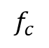
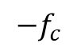
Last Unit: Up- and Down-Conversion
Analog Baseband
Real passband
upconversion
f
f
0
downconversion
0
$$−f_{c}$$
$$f_{c}$$
Upconversion in TX: Convert an analog baseband IQ to real passband
Downconversion in RX: Convert real passband to analog IQ
But, baseband signal is complex and analog
How do we transmit digital information?

Slide 6

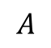

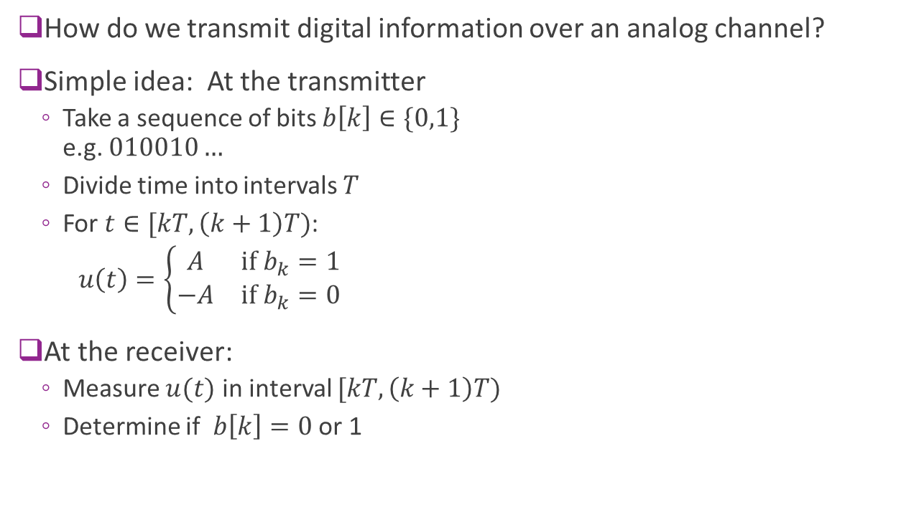


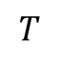

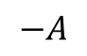

Simple Idea
How do we transmit digital information over an analog channel?
Simple idea: At the transmitter
Take a sequence of bits $b\left[k\right]∈\{0,1\}$ e.g. $010010…$
Divide time into intervals $T$
For $t∈[kT,\left(k+1\right)T)$:
$u\left(t\right)=\left\{\begin{matrix}A & \text{if} b_{k}=1 \\ −A & \text{if} b_{k}=0\end{matrix}\right.$
At the receiver:
Measure $u(t)$ in interval $[kT,\left(k+1\right)T)$
Determine if $b\left[k\right]=0$ or 1
Bits
$$0$$
$$1$$
$$0$$
$$0$$
$$1$$
$$0$$
$$A$$
$$−A$$
$$T$$

Slide 7
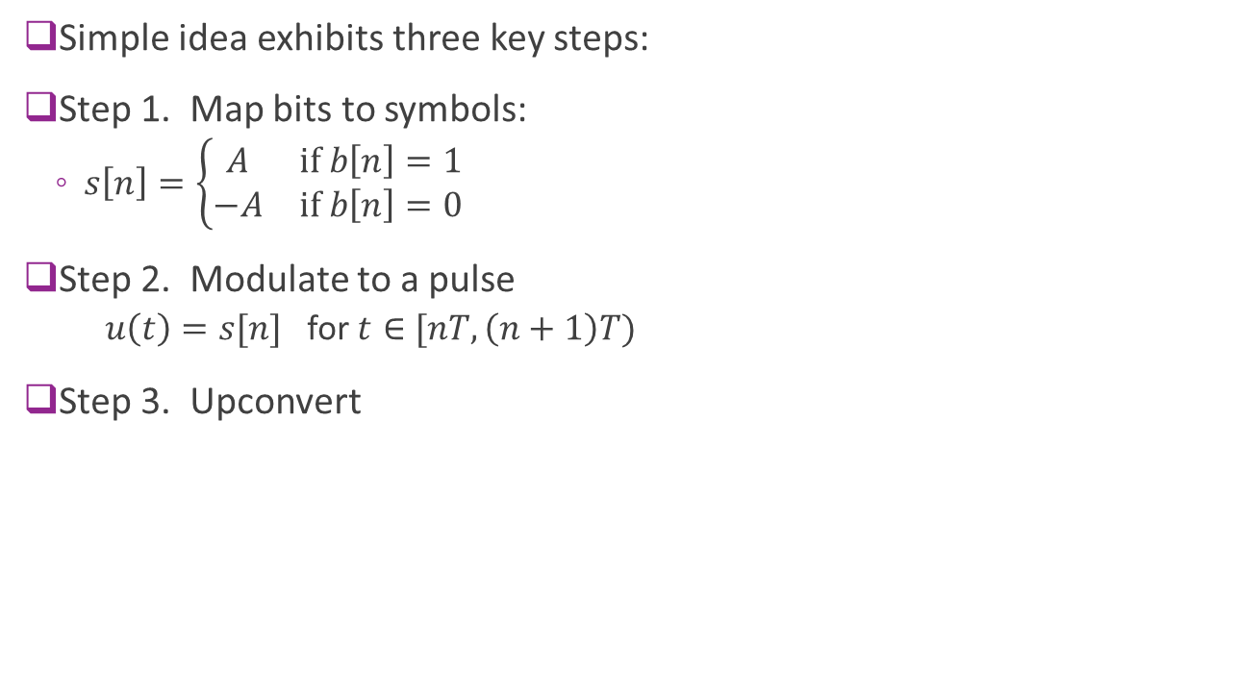
Simple Idea: Continued
Simple idea exhibits three key steps:
Step 1. Map bits to symbols:
$s\left[n\right]=\left\{\begin{matrix}A & \text{if} b\left[n\right]=1 \\ −A & \text{if} b\left[n\right]=0\end{matrix}\right.$
Step 2. Modulate to a pulse
$u\left(t\right)=s[n]$ for $t∈[nT,\left(n+1\right)T)$
Step 3. Upconvert
Bits
$$0$$
$$1$$
$$0$$
$$0$$
$$1$$
$$0$$
$$A$$
$$−A$$
$$T$$

Slide 8
Digital Modulation General Procedure
Complex symbols
Complex baseband
Real passband
Bits …101001…
Discrete-time
Continuous-time
Symbol mapping
DAC & pulse shaping
Upconversion
Most communication systems follow the same three steps
Step 1: Bit to symbol map
Step 2: Pulse shaping
Step 3: Upconversion (done in last class)

Slide 9
Step 1: Symbol Mapping
Complex symbols
Complex baseband
Real passband
Bits …101001…
Discrete-time
Continuous-time
Symbol mapping
DAC & pulse shaping
Upconversion
Generally done in three steps:
Step 1: Bit to symbol map
Step 2: Pulse shaping
Step 3: Upconversion (done in last class)

Slide 10
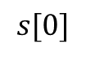
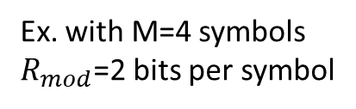
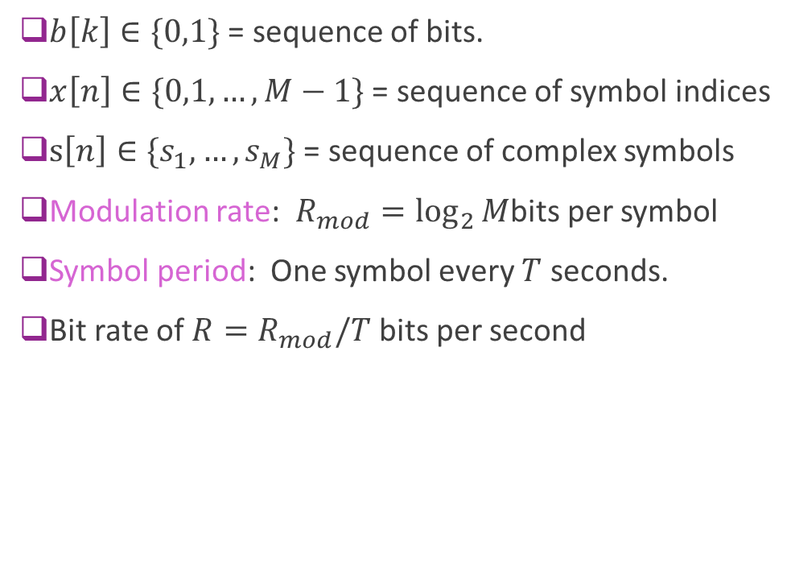
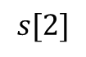
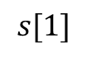
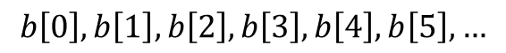
Step 1: Bit to Symbol Mapping
$b\left[k\right]∈\{0,1\}$ = sequence of bits.
$x\left[n\right]∈\{0,1,…,M−1\}$ = sequence of symbol indices
$s\left[n\right]∈\{s_{1},…, s_{M}\}$ = sequence of complex symbols
Modulation rate: $R_{mod}=\log_{2}{M}$bits per symbol
Symbol period: One symbol every $T$ seconds.
Bit rate of $R=R_{mod}/T$ bits per second
$$b\left[0\right],b\left[1\right], b\left[2\right], b\left[3\right],b\left[4\right], b\left[5\right],…$$
$$s[0]$$
$$s[1]$$
$$s[2]$$
T
Ex. with M=4 symbols $R_{mod}$=2 bits per symbol

Slide 11
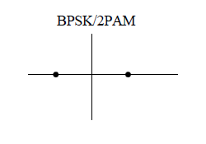
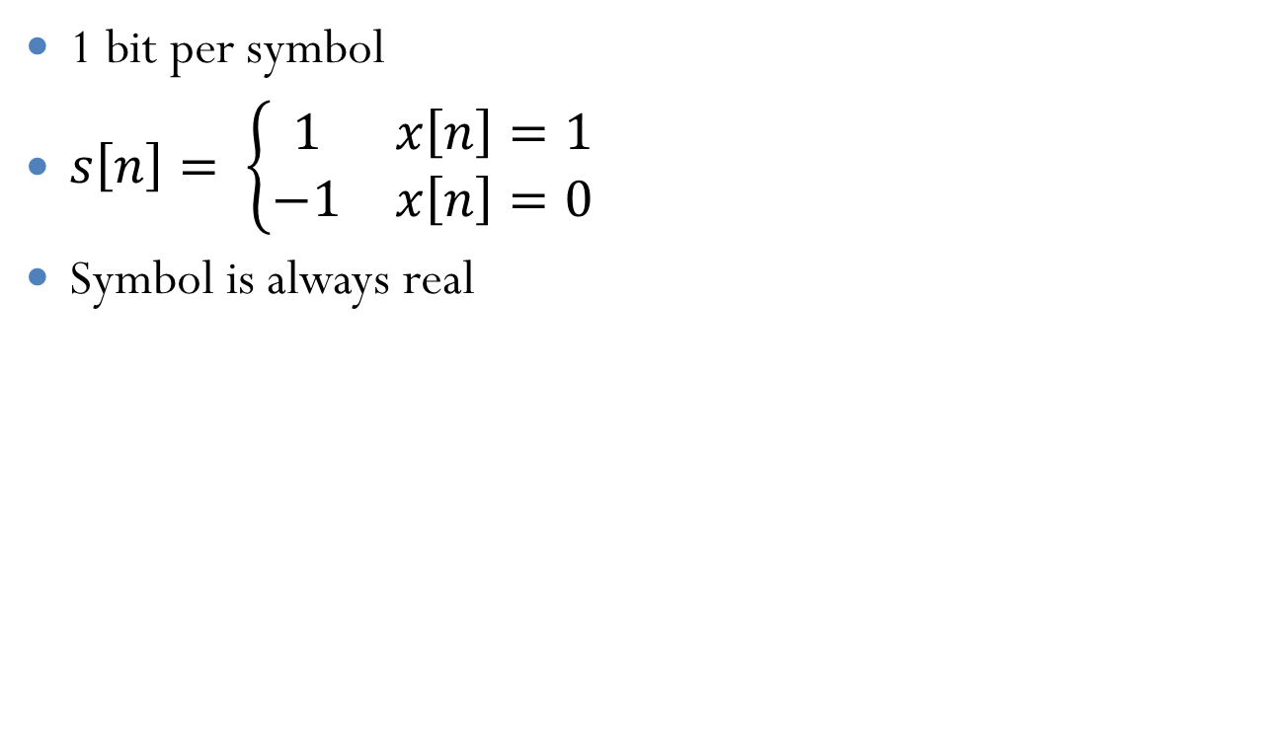
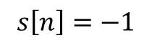
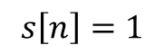
Example: BPSK
1 bit per symbol
$s\left[n\right]= \left\{\begin{matrix}1 & x\left[n\right]=1 \\ −1 & x\left[n\right]=0\end{matrix}\right.$
Symbol is always real
$$s\left[n\right]=−1$$
$$s\left[n\right]=1$$

Slide 12
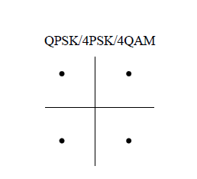
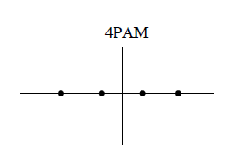
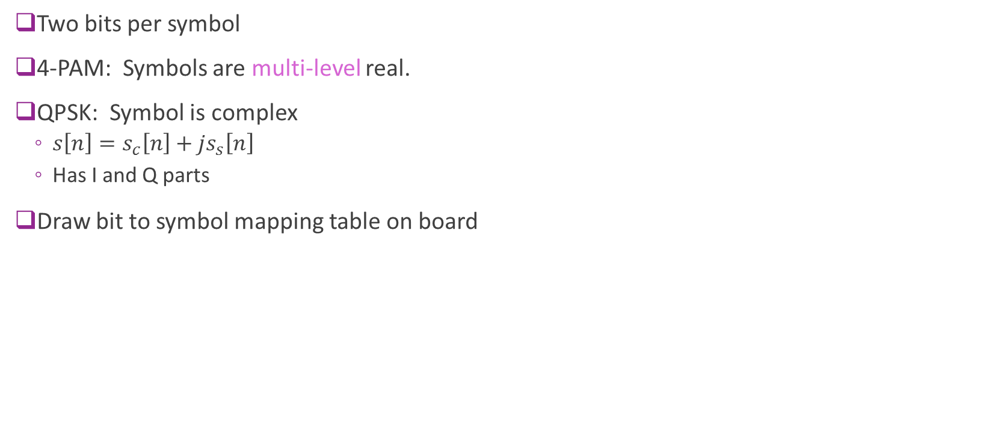
Example 2: 4-PAM and QPSK
Two bits per symbol
4-PAM: Symbols are multi-level real.
QPSK: Symbol is complex
$s\left[n\right]=s_{c}\left[n\right]+js_{s}\left[n\right]$
Has I and Q parts
Draw bit to symbol mapping table on board

Slide 13
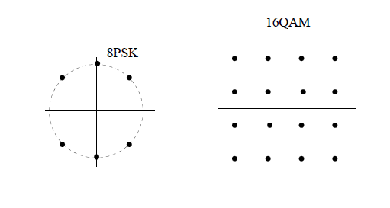
Higher-Order Modulation
Constellations go up to 1024 in wireline communications
Wireless is typically limited to 64-QAM (6 bits per symbol)
High order modulation:
Will see need very low noise to detect high order modulation correctly

Slide 14
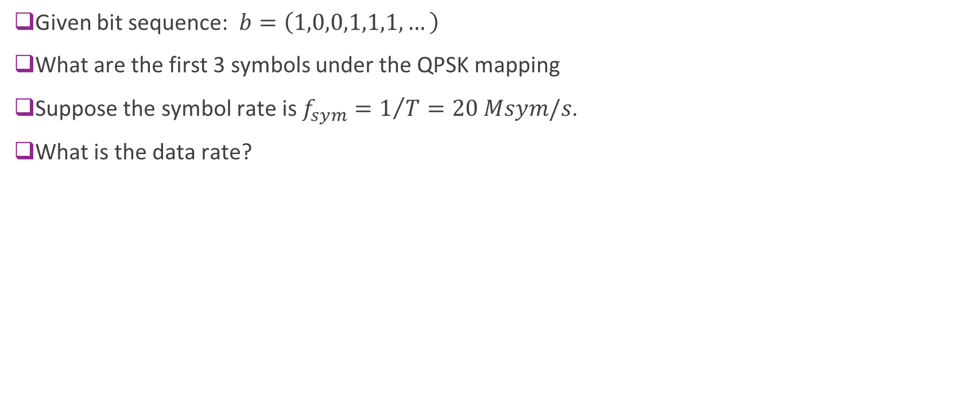
Example Problem
Given bit sequence: $b=\left(1,0,0,1,1,1,…\right)$
What are the first 3 symbols under the QPSK mapping
Suppose the symbol rate is $f_{sym}=1/T=20 Msym/s$.
What is the data rate?
01
11
00
10

Slide 15
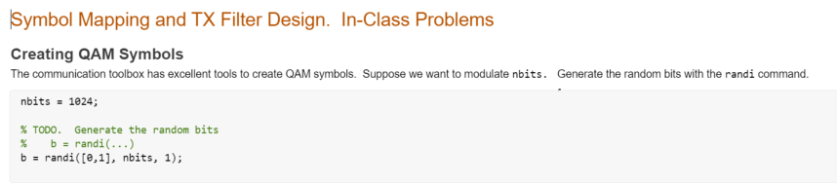
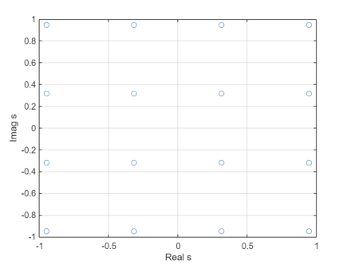
In Class Exercise

Slide 16
Outline
Symbol mapping
DAC and pulse shaping
Fourier analysis and bandwidth of TX filtering
Power spectral density analysis
Sinc pulse and Ideal low pass filtering
Digitally implementing pulse shaping

Slide 17
Step 2: DAC and Pulse Shaping
Complex symbols
Complex baseband
Real passband
Bits …101001…
Discrete-time
Continuous-time
Symbol mapping
DAC & pulse shaping
Upconversion
Generally done in three steps:
Step 1: Bit to symbol map
Step 2: Pulse shaping
Step 3: Upconversion (done in last class)

Slide 18
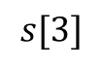
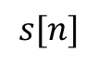
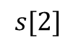
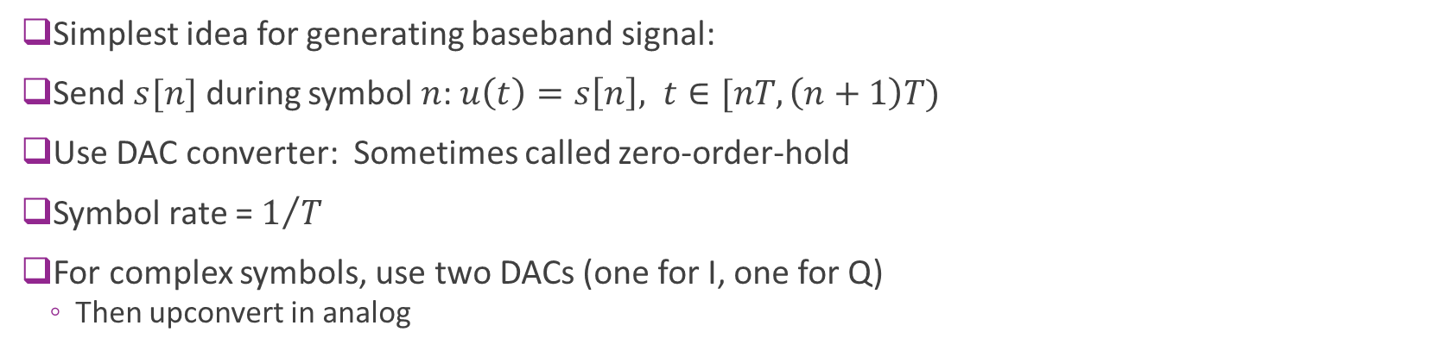
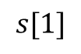
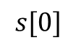
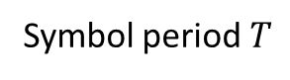
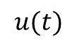
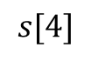
Digital-Analog Conversion (DAC)
$$s[0]$$
$$s[1]$$
$$s[2]$$
$$s[3]$$
$$s[4]$$
$$s[n]$$
$$u(t)$$
DAC
Symbol period $T$
Simplest idea for generating baseband signal:
Send $s[n]$ during symbol $n$: $u\left(t\right)=s\left[n\right], t∈[nT,\left(n+1\right)T)$
Use DAC converter: Sometimes called zero-order-hold
Symbol rate = $1/T$
For complex symbols, use two DACs (one for I, one for Q)
Then upconvert in analog

Slide 19
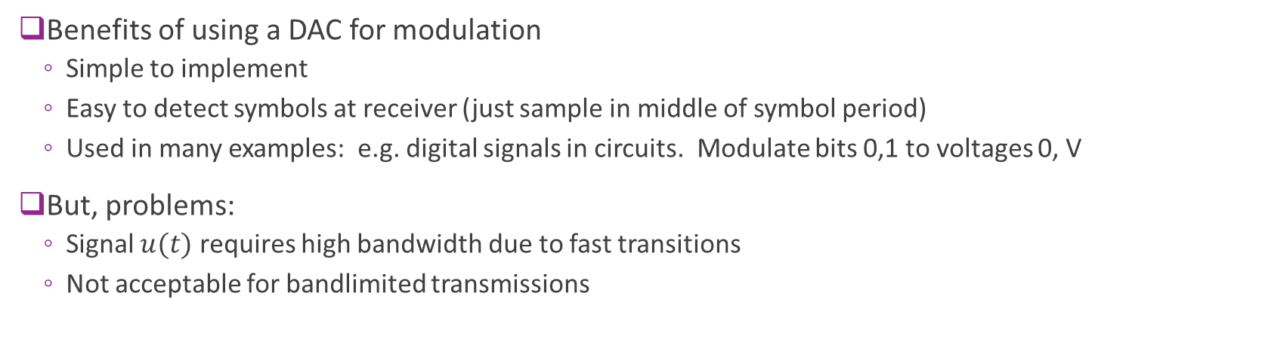
Problem with DAC only solution
$$s[0]$$
$$s[1]$$
$$s[2]$$
$$s[3]$$
$$s[4]$$
$$s[n]$$
$$u(t)$$
DAC
Benefits of using a DAC for modulation
Simple to implement
Easy to detect symbols at receiver (just sample in middle of symbol period)
Used in many examples: e.g. digital signals in circuits. Modulate bits 0,1 to voltages 0, V
But, problems:
Signal $u(t)$ requires high bandwidth due to fast transitions
Not acceptable for bandlimited transmissions

Slide 20
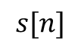
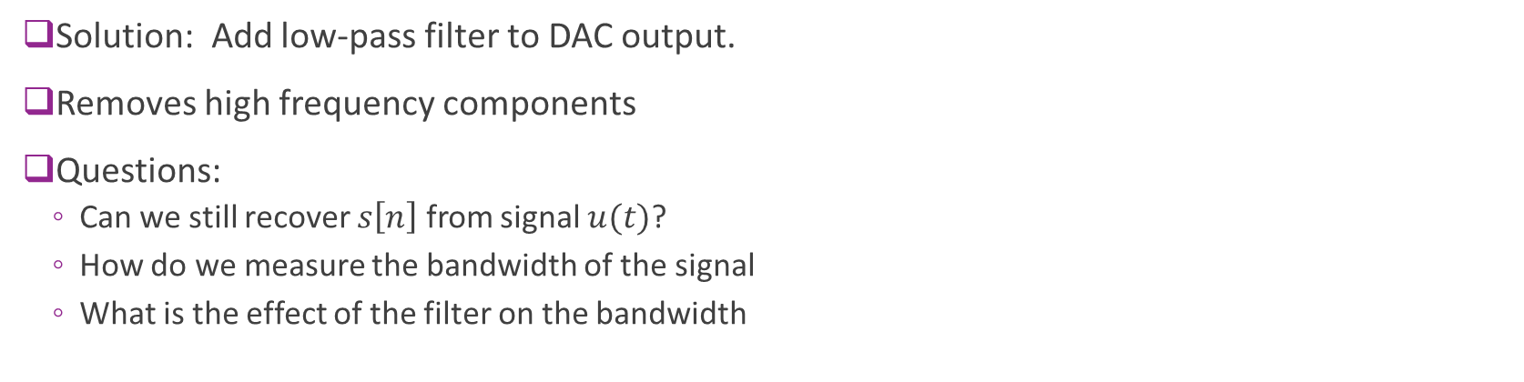
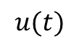
DAC + Filtering
$$s[n]$$
$$u(t)$$
DAC
Low-pass filter
DAC output before filtering
Filtered signal
Solution: Add low-pass filter to DAC output.
Removes high frequency components
Questions:
Can we still recover $s\left[n\right]$ from signal $u(t)$?
How do we measure the bandwidth of the signal
What is the effect of the filter on the bandwidth

Slide 21
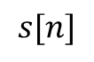
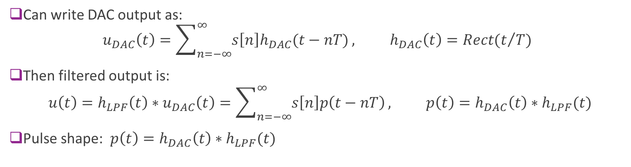
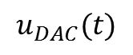
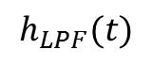
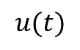
Infinite Pulse Series Representation
$$u_{DAC}(t)$$
$$u(t)$$
$$s[n]$$
$$h_{LPF}(t)$$
DAC
Low-pass filter
Can write DAC output as: $u_{DAC}\left(t\right)=\sum_{n=−∞}^{∞}{s\left[n\right]h_{DAC}(t−nT)}, h_{DAC}\left(t\right)=Rect(t/T)$
Then filtered output is:
$$u\left(t\right)=h_{LPF}\left(t\right)∗u_{DAC}\left(t\right)=\sum_{n=−∞}^{∞}{s\left[n\right]p\left(t−nT\right)}, p\left(t\right)=h_{DAC}\left(t\right)∗h_{LPF}(t)$$
Pulse shape: $p\left(t\right)=h_{DAC}\left(t\right)∗h_{LPF}(t)$

Slide 22
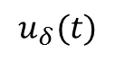
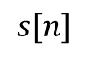
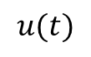
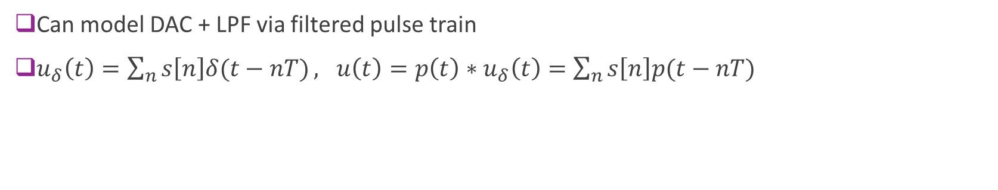

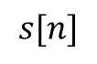
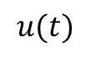
Theoretical Pulse Shape Model
Physical implementation
Model for analysis
$$s[n]$$
$$u(t)$$
$$s[n]$$
$$u(t)$$
$$u_{δ}(t)$$
Real DAC
(ex. Zero-order hold)
Low-pass filter
Ideal pulse DAC
Pulse shape filter $$p(t)$$
Can model DAC + LPF via filtered pulse train
$u_{δ}\left(t\right)=\sum_{n}{s\left[n\right]δ(t−nT)}, u\left(t\right)=p\left(t\right)∗u_{δ}\left(t\right)=\sum_{n}{s\left[n\right]p(t−nT)}$

Slide 23
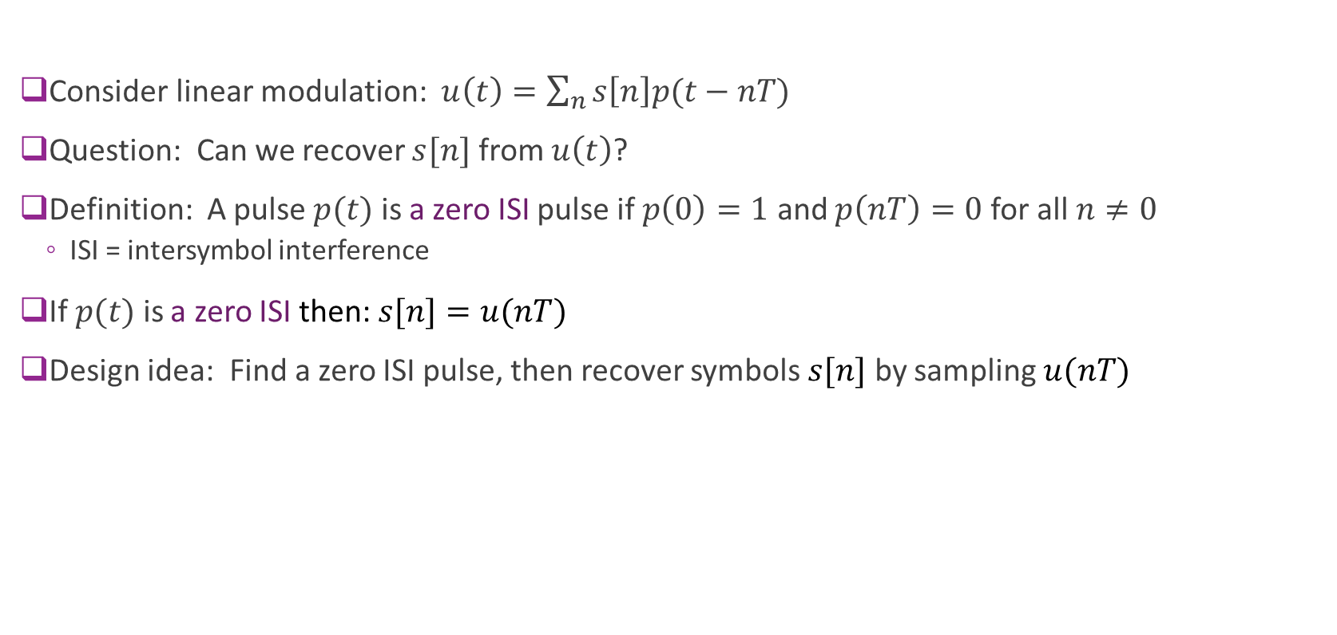
Zero ISI Pulse
Consider linear modulation: $u\left(t\right)=\sum_{n}{s\left[n\right]p(t−nT)}$
Question: Can we recover $s[n]$ from $u\left(t\right)$?
Definition: A pulse $p(t)$ is a zero ISI pulse if $p\left(0\right)=1$ and $p\left(nT\right)=0$for all $n≠0$
ISI = intersymbol interference
If $p(t)$ is a zero ISI then: $s[n]=u(nT)$
Design idea: Find a zero ISI pulse, then recover symbols $s[n]$ by sampling $u(nT)$

Slide 24
Simple Pulse Shapes
Pictures on board
Rectangular pulse: Leads to zero-order-hold
Triangular pulse: Leads to linear interpolation
Zero ISI condition

Slide 25
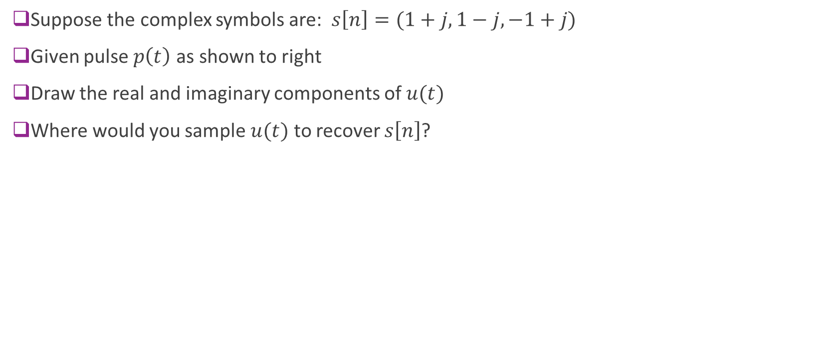
Sample Problem
Suppose the complex symbols are: $s\left[n\right]=(1+j,1−j,−1+j)$
Given pulse $p\left(t\right)$ as shown to right
Draw the real and imaginary components of $u(t)$
Where would you sample $u(t)$ to recover $s\left[n\right]$?
1
0
T
2T

Slide 26

Units in Linear Modulation
Suppose $u\left(t\right)=\sum_{n}{s\left[n\right]p(t−nT)}$
Units for $u(t)$:
${\left|u\left(t\right)\right|}^{2}$ represents instantaneous power
So, typically in this class ${\left|u\left(t\right)\right|}^{2}$ in W or mW
But $u(t)$ could also be in volts, volts/m (electric field).
In these cases, ${\left|u\left(t\right)\right|}^{2}$ is proportional to power.
Units for $s\left[n\right]$ and $p(t)$:
Many possible units
Convention in this class: ${\left|s[n]\right|}^{2}$ will have units of energy per sample (e.g., J or mJ/sample)
${\left|p\left(t\right)\right|}^{2}$ will have the units of samples per second (e.g., Hz, MHz, …)
Then product ${\left|s[n]\right|}^{2}{\left|p\left(t\right)\right|}^{2}$ will have units energy/time=power

Slide 27


In Class Exercise

Slide 28
Outline
Symbol mapping
DAC and pulse shaping
Fourier analysis and bandwidth of TX filtering
Power spectral density analysis
Sinc pulse and Ideal low pass filtering
Digitally implementing pulse shaping

Slide 29

Bandwidth and US Spectral Allocations

Slide 30
Bandwidth: A Basic Resource
Limited by:
Nature of the medium. Most channels can transmit only limited range of frequencies
Ownership / allocations
We will see that data rate is proportional to bandwidth
Assuming power per unit bandwidth is constant
Basic questions:
How do we measure bandwidth?
What is the bandwidth of linearly modulated signals?

Slide 31





Fourier Transform of Modulated Signal
Want to measure occupied bandwidth of $u(t)$
Look at FT $U(f)$
Problem: How do we compute FT of $U(f)$ ?
Depends on two factors:
DTFT of $s[n]$
Pulse shape filter response $P(f)$
$$s[n]$$
$$u(t)$$
$$u_{δ}(t)$$
Ideal pulse DAC
Pulse shape filter $$p(t)$$

Slide 32

Review of DTFT
Given discrete-time sequence $s[n]$
DTFT: $S\left(Ω\right)=\sum_{n}{s\left[n\right]e^{−jΩn}}$
Inverse DTFT: $s\left[n\right]=\frac{1}{2π}\int_{−π}^{π}{S\left(Ω\right)e^{jΩn}dΩ}$
Note $S\left(Ω\right)$ is always a $2π$ periodic signal
$Ω$ is the discrete frequency. Units is radians per sample.

Slide 33


Common DTFT Pairs
See Wikipedia

Slide 34

Fourier Analysis of Modulation
Computing $U(f)$ follows three steps:
Compute $S\left(Ω\right)$. This is $2π$ periodic
Compute $U_{δ}\left(f\right)=S\left(2πfT\right)=S\left(\frac{2πf}{f_{s}}\right)$
Vertical scale is unchanged
Digital frequency $Ω$ mapped to $f=\frac{Ω}{2πT}=\frac{Ωf_{s}}{2π}$
This is periodic with period $\frac{1}{T}=f_{s}$
Compute $U\left(f\right)=P\left(f\right)U_{δ}(f)$
$$s[n]$$
$$u(t)$$
$$u_{δ}(t)$$
Ideal pulse DAC
Pulse shape filter $$p(t)$$

Slide 35















Example Problem: Part 1
Given $S(Ω)$ as shown
Suppose $f_{s}=\frac{1}{T}=20 MHz$
Draw $U_{δ}(f)$
Solution: $U_{δ}\left(f\right)=S(2πfT)$
$U_{δ}(f)$ has period $f_{s}=20 MHz$
Same vertical scale as $S(Ω)$
$Ω=0.8π$ maps to $f=\frac{0.8π}{2π}\left(20\right)=8$ MHz
$Ω=π$ maps to $f=\frac{π}{2π}\left(20\right)=10$ MHz
$C$
$S(Ω)$
$−π$
0
$π$
$2π$
$−0.8π$
$0.8π$
$C$
$$U_{δ}(f)$$
$−10$
0
$10$
$$20$$
$−8$
$8$

Slide 36














Example Problem: Part 2
Suppose filter is: $P\left(f\right)=\left\{\begin{matrix}1 & \left|f\right|<10 \\ 0.1 & \left|f\right|∈[10,30) \\ 0 & \text{else}\end{matrix}\right.$
Draw $P(f)$ and $U(f)$
Solution
Use equation to draw $P(f)$
Get $U(f)$ from $U\left(f\right)=P\left(f\right)U_{δ}(f)$
In this case, filter attenuates two sidelobes
$C$
$$U_{δ}(f)$$
$−10$
0
$10$
$$20$$
$−8$
$8$
$C$
$$U\left(f\right)$$
$$P\left(f\right)$$
0.1$C$
$−30$
$−10$
0
$10$
$$20$$
$−8$
$$30$$
$8$

Slide 37
Outline
Symbol mapping
DAC and pulse shaping
Fourier analysis and bandwidth of TX filtering
Power spectral density analysis
Sinc pulse and Ideal low pass filtering
Digitally implementing pulse shaping

Slide 38






Review: PSD of a Continuous-Time Signal
Let $x(t)$ be a power signal
Select frequency $f_{0}$ to measure PSD
Filter with narrowband filter
$y\left(t\right)=h\left(t\right)∗x\left(t\right)$
$H\left(f\right)=1$ for $\left|f−f_{0}\right|≤Δ/2$
Measure power $P_{y}$
PSD at $f_{0}$ is defined as $S_{x}\left(f_{0}\right)≔ \lim_{Δ→0}{\frac{1}{Δ}}P_{y}$
Can show this is equivalent to window definition
Reveals how much power is in a certain frequency
$$Δ$$
$$x(t)$$
$$y(t)$$
$$P_{y}≈S_{x}(f_{0})Δ$$
$H\left(f\right):$Narrowband filter around $f_{0}$
Power meter

Slide 39





PSD of a Discrete-Time Signal
Can define PSD of a discrete-time power signal similarly
Let $x[n]$ be a discrete-time signal
Select frequency $Ω_{0}$ to measure PSD
Filter with narrowband filter
$y[n]=h[n]∗x[n]$
$H\left(Ω\right)=1$ for $\left|Ω−Ω_{0}\right|≤Δ/2$
Measure power $P_{y}=\lim_{N}{\frac{1}{2N}\sum_{n=−N}^{N}{{\left|y\left[n\right]\right|}^{2}}}$
PSD at $Ω_{0}$ is defined as $S_{x}\left(Ω_{0}\right)≔ \lim_{Δ→0}{\frac{1}{Δ}}P_{y}$
$$Δ$$
$$x[n]$$
$$y[n]$$
$$P_{y}≈S_{x}(Ω_{0})Δ$$
$H\left(Ω\right):$Narrowband filter around $Ω_{0}$
Power meter

Slide 40

Units of Discrete-Time PSD
Recall, by convention: $|s\left[n\right]{\left.​\right|}^{2}$ has units of energy (e.g. Joules)
Power $P=\lim_{N}{\frac{1}{2N}\sum_{n=−N}^{N}{{\left|s\left[n\right]\right|}^{2}}}$
Units are energy per sample
Or, simply energy (e.g . Joules)
Discrete-time PSD:
$S_{s}\left(Ω\right)=\lim_{δ}{\frac{1}{δ}\text{Power} \text{in} \text{freq} \text{bin}}$
Units are energy per sample per radian
In dB scale: dBJ / radian or dBmJ per radian

Slide 41

Symbol Mean and Energy
Consider a linear modulated signal: $u\left(t\right)=\sum_{n=−∞}^{∞}{s\left[n\right]p(t−nT)}$
What is its PSD?
Assume $s\left[n\right]∈\{s_{1},…,s_{M}\}$. $M$ constellation points
Define symbol mean and symbol energy: $\overline{s}=\frac{1}{M}\sum_{m=1}^{M}{s_{m}}, E_{s}=\frac{1}{M}\sum_{m=1}^{M}{{\left|s_{m}−\overline{s}\right|}^{2}}$

Slide 42

PSD of a Linear Modulated Signal
Suppose: Output of ideal DAC is
$$u_{δ}\left(t\right)=\sum_{n=−∞}^{∞}{s\left[n\right]δ(t−nT)}$$
After pulse shaping: $u\left(t\right)=p\left(t\right)∗u_{δ}\left(t\right)=\sum_{n=−∞}^{∞}{s\left[n\right]p(t−nT)}$
Suppose $s[n]$ is a discrete-time power signal with digital PSD $S_{s}(Ω)$
Theorem: PSD of $u_{δ}\left(t\right)$and $u\left(t\right)$ $S_{u_{δ}}\left(f\right)=\frac{1}{T}S_{s}\left(2πfT\right), S_{u}\left(f\right)=\frac{1}{T}S_{s}(2πfT){\left|P\left(f\right)\right|}^{2}$
Note that $S_{s}(2πfT)$ is periodic with period $\frac{1}{T}$.

Slide 43

Units of PSD Formula
From previous slide: $S_{u}\left(f\right)=\frac{1}{T}S_{s}(2πfT){\left|P\left(f\right)\right|}^{2}$
${\left|p\left(t\right)\right|}^{2}$ has units samples/second or frequency
${\left|P\left(f\right)\right|}^{2}$ has units samples/Hz or samples x time
Why? Since $∫{\left|P\left(f\right)\right|}^{2}df=∫{\left|p\left(t\right)\right|}^{2}dt$
$S(2πfT)$ has units energy per sample
Hence units of $S_{u}\left(f\right)=\frac{1}{\text{time}}×\frac{\text{energy}}{\text{sample}}×\text{(}\text{sample}×\text{time}\text{)=}\text{energy}$
This is consistent with our earlier units:
Units of $S_{u}\left(f\right)$ is power / Hz = energy

Slide 44

Special Case: IID Symbols
Suppose: Output of ideal DAC is $u_{δ}\left(t\right)=\sum_{n=−∞}^{∞}{s\left[n\right]δ(t−nT)}$
After pulse shaping: $u\left(t\right)=p\left(t\right)∗u_{δ}\left(t\right)=\sum_{n=−∞}^{∞}{s\left[n\right]p(t−nT)}$
Suppose that:
Assume $s\left[n\right]$ are uncorrelated and zero mean
Average symbol energy: $E_{s}=E{\left|s\left[n\right]\right|}^{2}$
Then $S_{s}\left(Ω\right)=E_{s}$
$S_{u_{δ}}\left(f\right)=\frac{1}{T}E_{s},$
$S_{u}\left(f\right)=\frac{1}{T}E_{s}{\left|P\left(f\right)\right|}^{2}$
Power $P_{u}=\frac{1}{T}E_{s}{\left\|p\right\|}^{2}$

Slide 45












Example Problem: Part 1
Given PSD of $s[n]$ $S_{s}(Ω)$ as shown with $C=0.1$
Suppose $f_{s}=\frac{1}{T}=20 MHz$
Draw PSD of $U_{δ}(f)$
Solution: $S_{δ}\left(f\right)=\frac{1}{T}S(2πfT)$
$S_{δ}(f)$ has period $f_{s}=20 MHz$
Vertical scaled by $\frac{1}{T}$
$Ω=0.7π$ maps to $f=\frac{0.7π}{2π}\left(20\right)=7$ MHz
$Ω=π$ maps to $f=\frac{π}{2π}\left(20\right)=10$ MHz
$C$
$S_{s}(Ω)$
$−π$
0
$π$
$2π$
$−0.7π$
$0.7π$
$C/T$
$$S_{δ}(f)$$
$−10$
0
$10$
$20$
$−7$
$7$

Slide 46










Example Problem: Part 2
$C/T$
Now suppose $p\left(t\right)=sinc\left(\frac{t}{T}\right)$
Draw $S_{u}(f)$
Solution:
$P\left(f\right)=TRect\left(fT\right)$
${\left|P\left(f\right)\right|}^{2}=T^{2}Rect(fT)$
Scales low-pass signal by $T^{2}$
Removes all sideloble
Total power in the signal:
Area of a trapezoid
$P_{u}=∫S_{u}\left(f\right)df=\frac{CT}{2T}\left[0.7+1\right]=0.85C$
$$S_{δ}(f)$$
$−10$
0
$10$
$20$
$−7$
$7$
$$T^{2}$$
$CT$
$$S_{u}\left(f\right)={\left|P\left(f\right)\right|}^{2}S_{δ}(f)$$
$−10$
0
$10$
$20$
$−7$
$7$

Slide 47



Measuring Bandwidth
PSD of modulated bits is $S_{u}\left(f\right)=\frac{1}{T}E_{s}{\left|P\left(f\right)\right|}^{2}$
Complex baseband signal
After upconversion will be shifted to $±f_{c}$
Definition: Signal is exactly band-limited to $\left|f\right|≤W$
if $S_{u}\left(f\right)=0$ for $\left|f\right|≥W$
Exact bandwidth = $2W$
Approximate BW: Typically require $S_{u}\left(f\right)≈0$ for $\left|f\right|≥W$
Different measures of approximate bandwidth
3 dB bandwidth
98% bandwidth, …

Slide 48

Examples
Recangular pulse: $p\left(t\right)=\frac{1}{T}I_{[−\frac{T}{2},\frac{T}{2}]}⇒{\left|P\left(f\right)\right|}^{2}=sinc^{2}\left(fT\right)$
99% bandwidth = 10.1/T, 90% BW = 0.85/T
Sinusoidal pulse (for $T=1$): $p\left(t\right)=\sqrt{2}\sin\left(πt\right)I_{\left[0,1\right]}\left(t\right)$ ${\left|P\left(f\right)\right|}^{2}=\frac{8}{π^{2}}\frac{\cos^{2}{πf}}{{\left(1−4f^{2}\right)}^{2} }$
No discontinuities. Less very high frequency components
99% bandwidth = 1.2/T

Slide 49

Spectral Masks
Bandwidths for wireless devices are regulated
Must transmit most energy in some specified band
Ensures no interference between channels
Constraints are specified by a spectral mask
Represents maximum power level in each band
Emissions outside the main band typically very low
At least 20 to 40 dB below main lobe
Channels for 802.11ad
Each channel is 2.16 GHz

Slide 50


Signal Bandwidth and Excess Bandwidth
Usually, signal of interest is contained in smaller band
Signal bandwidth < occupied bandwidth
Excess bandwidth = Occupied – Signal bandwidth
Allows a transition region
Filters cannot roll off infinitely fast
802.11ad example:
Sample rate typically 1.76 Gsamp/s
Lower frequencies, excess bandwidth is even smaller
Ex. LTE 20 MHz channel
Signal bandwidth = 18 MHz
Excess bandwidth $≈10\%$
Spectral mask for 802.11ad
Signal bandwidth=1.76 GHz
Occupied bandwidth=2.16 GHz
Excess bandwidth=22%

Slide 51


In Class Exercise

Slide 52
Outline
Symbol mapping
DAC and pulse shaping
Fourier analysis and bandwidth of TX filtering
Power spectral density analysis
Sinc pulse and Ideal low pass filtering
Digitally implementing pulse shaping

Slide 53

Design Goals
Want to design pulse with two goals
Goal 1. Bandwidth limits:
Most systems (esp. RF) impose bandwidth limits on transmissions.
PSD of modulated bits is $S_{u}\left(f\right)=\frac{1}{T}E_{s}{\left|P\left(f\right)\right|}^{2}$
Want ${\left|P\left(f\right)\right|}^{2}≈0$ for $\left|f\right|≥W$ where $W$ is (single-sided) bandwidth limit
Goal 2: Recover symbols $s[n]$ from $u(t)$
Sufficient condition: Use zero ISI pulse
Then recover with correct sampling
Can we find a pulse shape satisfying both goals?

Slide 54


Sinc Pulse
Use sinc pulse $p\left(t\right)=sinc(t/T)$
Satisfies zero ISI condition:
$p\left(nT\right)=0$ for $n≠0$
Pulse shape frequency response: $P\left(f\right)=TRect(fT)$
$P\left(f\right)=0$ for $\left|f\right|>1/{2T}$
Two-sided bandwidth is $=1/T$
Conclusion: sinc pulse satisfies two goals
If BW limit > $1/T$

Slide 55

Sinc Pulse Shaping Illustrated
BPSK symbols
Sinc pulse interpolates the symbols exactly
No out of band emissions
But:
Waveform varies rapidly between samples
Synchronization offsets will cause errors
High peak-to-average ratio
Needs an infinite length to implement

Slide 56



Cosine Filtering
Set of filters parametrized by $β$
$β∈[0,1]$ is called the rolloff
Excess bandwidth percentage $β$
$β=0⇒$ Ideal sinc filter
No excess bandwidth.
$β>0$
Creates excess bandwidth
But, allows shorter filter

Slide 57


Cosine Filtering Illustrated
Plotted to the right:
BPSK symbols filtered with raised cosine filters
Higher values of $β$
Symbol transitions are faster
More out-of-band emissions
But, less peak-to-average
Less variations between symbols

Slide 58
Outline
Symbol mapping
DAC and pulse shaping
Fourier analysis and bandwidth of TX filtering
Power spectral density analysis
Sinc pulse and Ideal low pass filtering
Digitally implementing pulse shaping

Slide 59
Problems with Analog LPF solution
$$u_{DAC}(t)$$
$$u(t)$$
$$s[n]$$
$$h_{LPF}(t)$$
DAC
Low-pass filter
Up to now, we have assumed simple two stage linear modulation
DAC followed by LPF
Challenges: LPF must be implemented in analog.
Want LPF filter to approximate ideal Rectangular response
Difficult to implement in analog
Analog filters typically have limited roll-off

Slide 60







Practical Pulse Shaping Block Diagram
Complex symbols $s[n]$ rate =$f_{0}$
$s_{M}[n]$ rate $f_{1}=Mf_{0}$
$u(t)$ Complex baseband
Upsample by $M$ with zero insertion
$H_{dig}\left(Ω\right)$ Digital LPF, cutoff $π/M$
$p_{dac}\left(t\right)$ DAC
$H_{ana}\left(f\right)$ Analog LPF, cutoff $f_{0}$
Practical pulse shaping:
Combination of analog and digital filtering

Slide 61

Practical Pulse Shaping
Start with symbols $s[n]$ at $f_{0}$
Upsample by $M$ with zero insertion
$s_{M}\left[k\right]=\left\{\begin{matrix}s[n] & k=Mn \\ 0 & k≠Mn \end{matrix}\right.$
Digitally filter with $H_{dig}(Ω)$
Pulse shape with DAC $p_{dac}(t)$
Analog filter $H_{ana}(f)$

Slide 62

Frequency Domain Analysis 1
$S(Ω)$ = DTFT of $s[n]$ at symbol rate $f_{0}$
Step 1: Upsample with zero insertion: $s_{M}\left[k\right]=\left\{\begin{matrix}s[n] & k=Mn \\ 0 & k≠Kn \end{matrix}\right.$ $S_{M}\left(Ω\right)=S\left(MΩ\right)$
Upsampled signal has symbol rate $f_{s1}=Mf_{s0}$
Step 2: Digital filter with DTFT $H_{dig}\left(Ω\right)$ $x\left[k\right]=h_{dig}\left[k\right]∗s_{M}\left[k\right]⇒X\left(Ω\right)=H_{dig}\left(Ω\right)S_{M}(Ω)$
Design filter to have cutoff at $Ω=π/M$
Theoretically, can use infinite sinc
But, in practice use long FIR filter

Slide 63

Frequency Domain Interpretation 2
Step 3: DAC and analog filtering
Create an impulse train $x_{δ}\left(t\right)=\sum_{k}{x\left[k\right]δ(t−nT/M)}⇒ X_{δ}\left(f\right)=X\left(\frac{2πfT}{M}\right)$
Repeated images once every $M/{T=f_{1}=Mf_{0}}$
Then, $U\left(f\right)=X_{δ}\left(f\right)P_{dac}\left(f\right)H_{ana}(f)$
Cut-off frequency of $H_{ana}(f)$ at $f_{0}$
Removes images $f_{1},2f_{1},…$

Slide 64















Images 1
$S(Ω)$
$C$
Complex symbols
Upsampling w/ zero insertion ($M=2$ shown)
Digital filtering
0
$π$
$2π$
$C$
$S_{M}(Ω)$
0
$\frac{π}{2}$
$π$
$$\frac{3π}{2}$$
$2π$
$C$
0
$π$
$2π$
Cutoff= $\frac{π}{2}$

Slide 65








Images 2
Pulse train
DAC and analog filtering
$C$
$$X_{δ}(f)$$
0
$$f_{0}$$
$$2f_{0}$$
$C$
$$U(f)$$
0
$$2f_{0}$$
Cutoff=$f_{0}$

Slide 66

Power Spectral Density
Suppose symbols $s\left[n\right]$ are i.i.d. with $E\left(s\left[n\right]\right)=0, E{\left|s\left[n\right]\right|}^{2}=E_{s}$
Can show PSD of $u\left(t\right)$ is: $S_{u}\left(f\right)=\frac{E_{s}}{{MT}_{0}}{\left|P\left(f\right)\right|}^{2}$
Effective pulse shape: $P\left(f\right)=H_{dig}\left(\frac{2πf}{Mf_{0}}\right)P_{dac}\left(f\right)H_{ana}(f)$

Slide 67

Effective Pulse Shape
Can show that the resulting signal is $u\left(t\right)=∑s\left[n\right]p(t−nT)$
Effective pulse shape is: $p\left(t\right)=\sum_{k}{h_{dig}\left[k\right]g\left(t−\frac{k}{M}T\right)}$
$g\left(t\right)=h_{ana}\left(t\right)∗p_{dac}(t)$

Slide 68

Example TX Filtering Circuit
Analog Devices AD9361 Wideband TXCR
TX filtering performed in two stages:
Digital filtering:
Multiple stages of interpolation
Programmable depending on sample rate
Analog filtering (after DAC)
Depends on channel bandwidth
RX
TX
Analog TX filter
Digital TX filter

